Slide 1
CS 410 – Final Presentation Stock Market Tweet Analysis
Team: Eastern Center
Kasam Dhakal (kdhakal2@illinois.edu)
Nisarg Mistry (nmistry2@illinois.edu)
Parth Shukla (pshukl21@illinois.edu )
Source Code: https://github.com/kasamdh/CourseProject/blob/main/StockMarketSentimentAnalysis.ipynb
Date: 12/05/2022

Slide 2
Stock Market Tweet Analysis
Overview
Tools, Systems, or Dataset
Instructions how to use software
Process flow diagram
Processing
Data Collection, Data Cleaning, Vectorization and TF-IDF Transformer
Analysis
Sentiment Analysis and Data Visualization
Results
Logistic Regression, Support Vector Machine, Decision Tree Classifier, Naïve Bayes Classifier, Stochastic Gradient Descent Classifier, K Nearest Neighbors Classifier, Random Forest Classifier, Gradient Boosting Classifier, XGBoost Classifier.

Slide 3

Stock Market Tweet Analysis
Overview
Goal:
Capture sentiment analysis, collect Twitter sentiment towards the stock market.
GitHub:
https://github.com/kasamdh/CourseProject/blob/main/StockMarketSentimentAnalysis.ipynb
Documentation and Final Report:
https://github.com/kasamdh/CourseProject/blob/main/Final_Project_Documentation.pdf

Slide 4
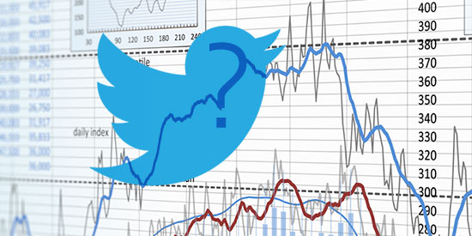
Stock Market Tweet Analysis
Tools, Systems, or Dataset
Google Collab
http://www.tweepy.org/ - Python Library to access the Twitter API
http://www.nltk.org/ - Natural Language Toolkit
Twitter data from Kaggle: https://www.kaggle.com/datasets/utkarshxy/stockmarkettweets-lexicon-data for Sentiment Analysis.
https://devpost.com/software/tweetpredict

Slide 5


Stock Market Tweet Analysis
Instructions on how to install the software
For this project we have used Google Collab
Login to the google account. Create a new account if you don’t have already.
Download the source code from GitHub.
https://github.com/kasamdh/CourseProject/blob/main/StockMarketSentimentAnalysis.ipynb
3. Upload the source code to Collab (http://colab.research.google.com/)
Steps: From http://colab.research.google.com/
Select: File ->Upload Notebook->Upload->Choose File

Slide 6

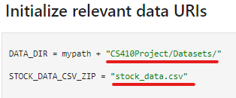
Stock Market Tweet Analysis
Instructions on how to install the software (Contd…..)
4. Dataset Connection to Connect to Google Drive:
(https://github.com/kasamdh/CourseProject/blob/main/stock_data.csv)
Steps: Download the stock_data.csv from GitHub and upload data set to the Google Drive.
File path : Copy the file path from the Google Drive and replace it to DATA+DIR = mypath + “ ” in the Initilized relevant data URI’s section in Google Collab

Slide 7
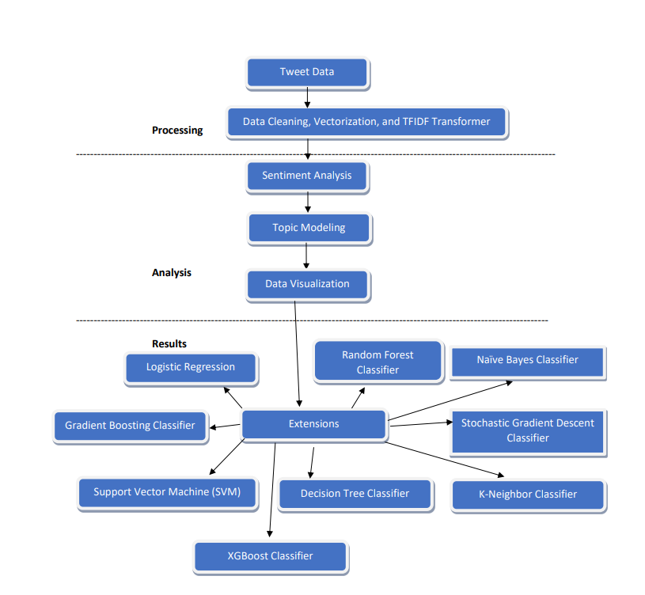
Stock Market Tweet Analysis
Process flow diagram

Slide 8
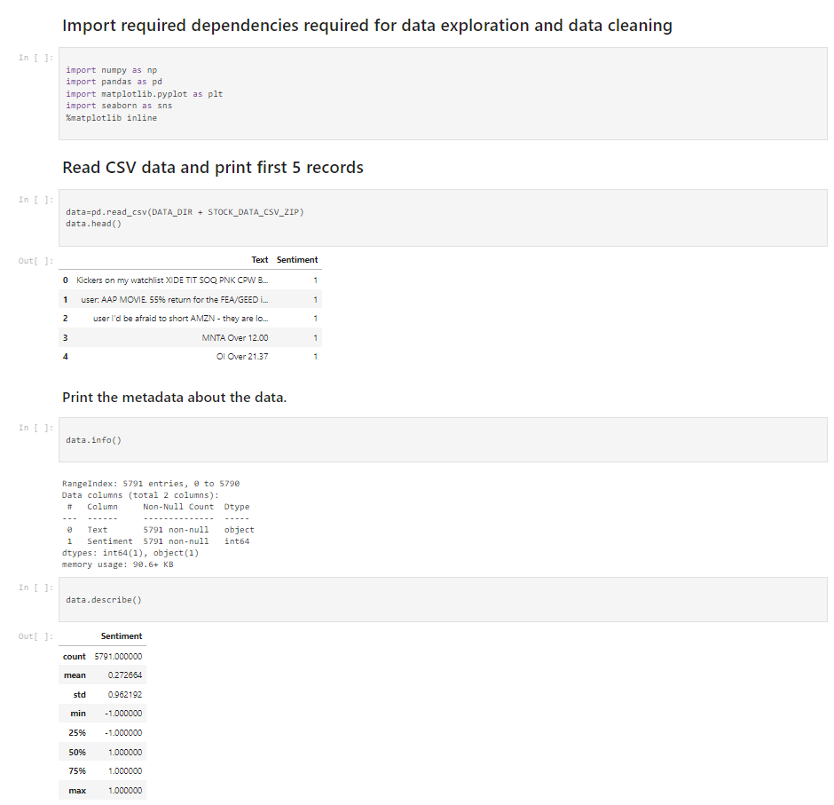
Stock Market Tweet Analysis
Processing
Data Collection:
Tweet data from https://www.kaggle.com/datasets/utkarshxy/stockmarkettweets-lexicon-data for Sentiment Analysis.

Slide 9
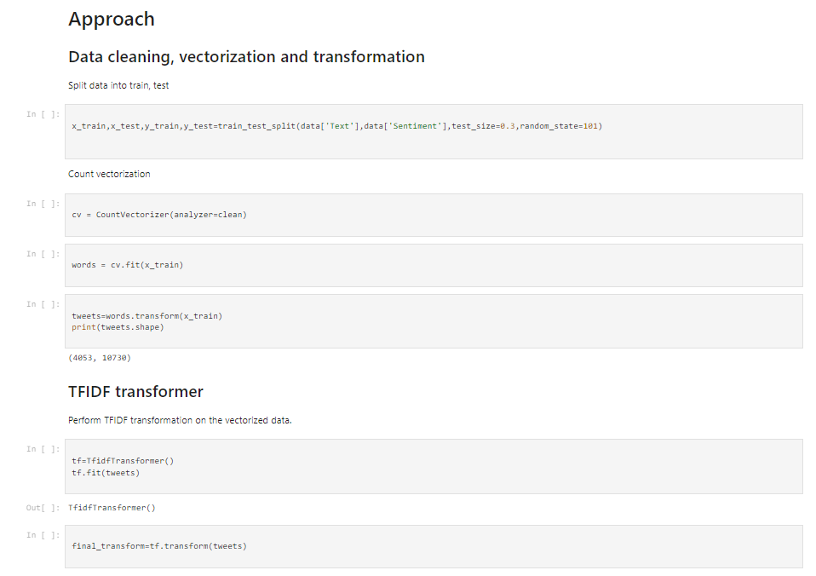
Stock Market Tweet Analysis
Processing
Data Cleaning: Import Stopwords corpus for cleaning the tweets, split data into train, test.
Vectorization: There are set of techniques use for extracting meaningful information from text corpus. Which is word vectorization. A word in a vector in the text corpus.
TF-IDF Transformer: The vectorization method widely used in text mining to reflect the importance of a term to a document in the corpus.

Slide 10
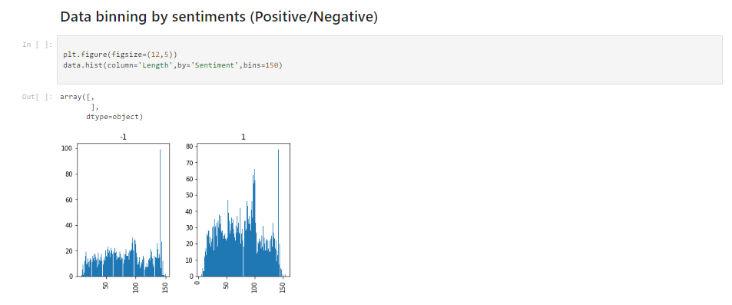
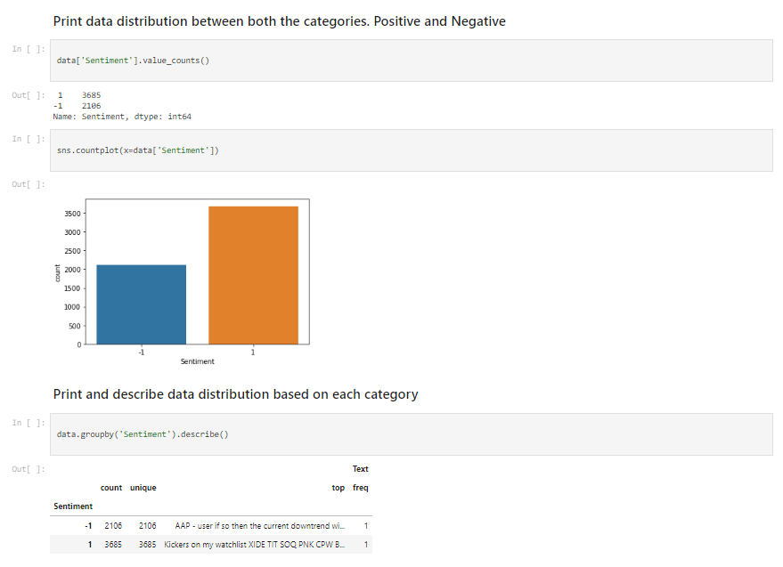
Stock Market Tweet Analysis
Analysis
Sentiment Analysis and Data Visualization
Labeled data corpus for Sentiment AnalysisSentimentIntensityAnalyzer: library for classifying into groups of sentimentsResults exported in text files
Outputs:
Probability of positive and negative
Compound values in a range of -1 to 1, where -1 represents negative for each tweet
The compound value is comparable to a single measure of polarity

Slide 11
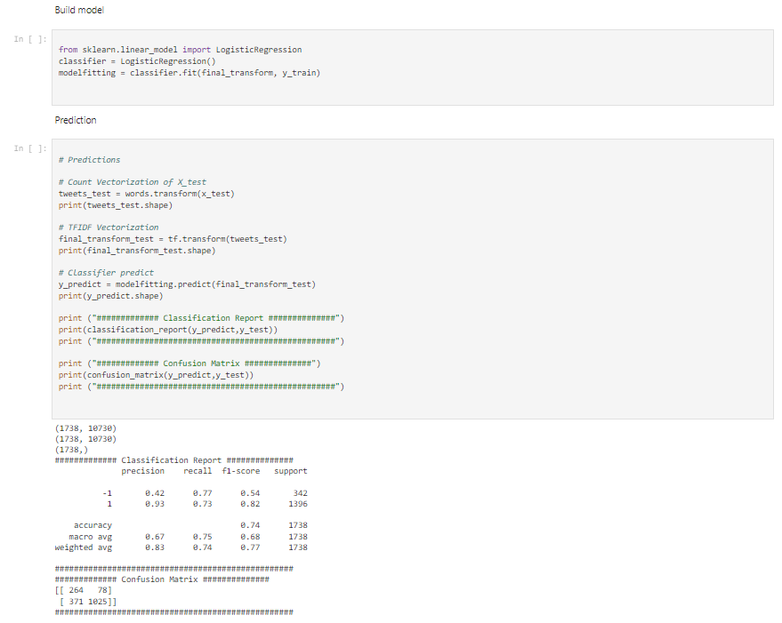
Stock Market Tweet Analysis
Results
Logistic Regression:
Logistic regression is a supervised learning classification algorithm used to predict the probability of a target variable. The nature of target or dependent variable is dichotomous, which means there would be only two possible classes.
In simple words, the dependent variable is binary in nature having data coded as either 1 (stands for success/yes) or 0 (stands for failure/no). Logistic regression model predicts P(Y=1) as a function of X.

Slide 12
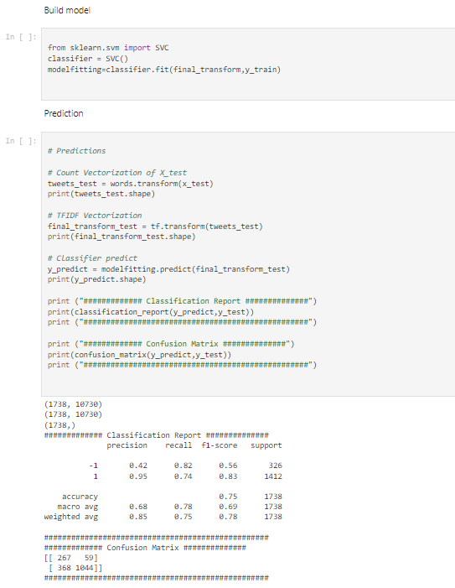
Stock Market Tweet Analysis
Results
Support Vector Machine: An SVM model is basically a representation of different classes in a hyperplane in multidimensional space. The hyperplane will be generated in an iterative manner by SVM so that the error can be minimized. The goal of SVM is to divide the datasets into classes to find a maximum marginal hyperplane (MMH).
The followings are important concepts in SVM −
Support Vectors − Datapoints that are closest to the hyperplane is called support vectors. Separating line will be defined with the help of these data points.
Hyperplane − As we can see in the above diagram, it is a decision plane or space which is divided between a set of objects having different classes.
Margin − It may be defined as the gap between two lines on the closet data points of different classes. It can be calculated as the perpendicular distance from the line to the support vectors. Large margin is considered as a good margin and small margin is considered as a bad margin.
The main goal of SVM is to divide the datasets into classes to find a maximum marginal hyperplane (MMH)

Slide 13
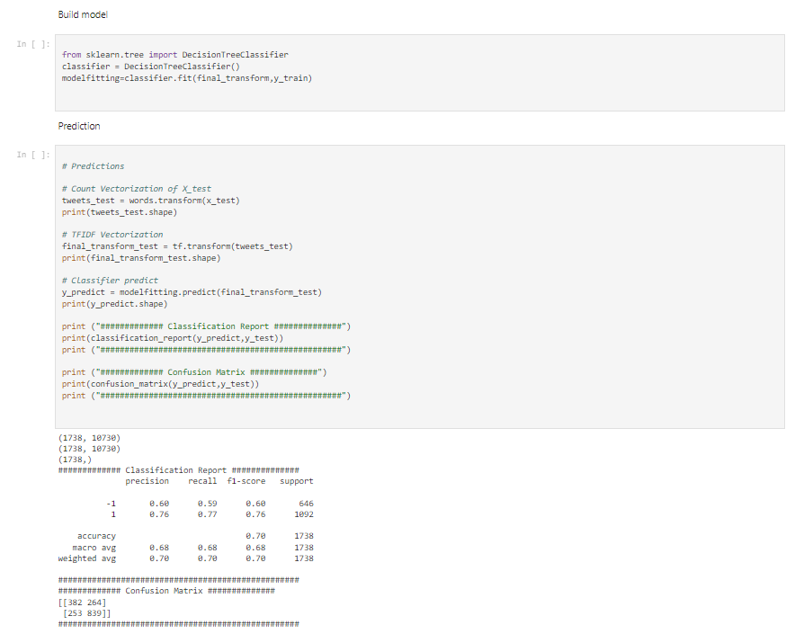
Stock Market Tweet Analysis
Results
Decision Tree Classifier:
Decision tree analysis is a predictive modelling tool that can be applied across many areas. Decision trees can be constructed by an algorithmic approach that can split the dataset in different ways based on different conditions. The two main entities of a tree are decision nodes, where the data is split and leaves, where we got outcome.

Slide 14
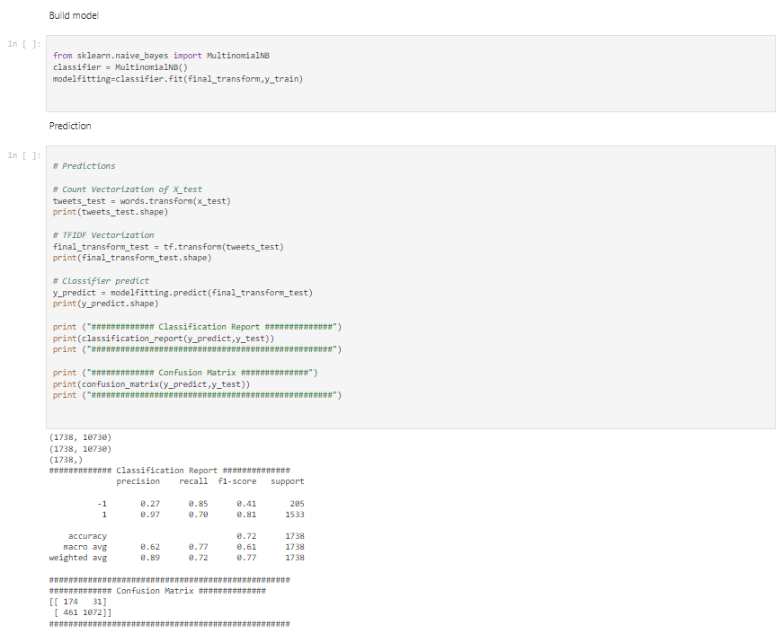
Stock Market Tweet Analysis
Results
Naive Bayes Classifier
Naïve Bayes algorithms is a classification technique based on applying Bayes’ theorem with a strong assumption that all the predictors are independent to each other. In simple words, the assumption is that the presence of a feature in a class is independent to the presence of any other feature in the same class.
In Bayesian classification, the main interest is to find the posterior probabilities

Slide 15
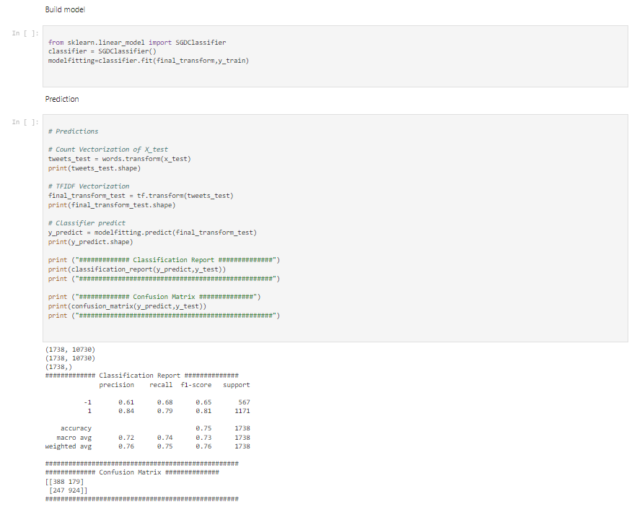
Stock Market Tweet Analysis
Results
Stochastic Gradient Descent Classifier:
This estimator implements regularized linear models with stochastic gradient descent (SGD) learning: the gradient of the loss is estimated each sample at a time and the model is updated along the way with a decreasing strength schedule (aka learning rate)

Slide 16
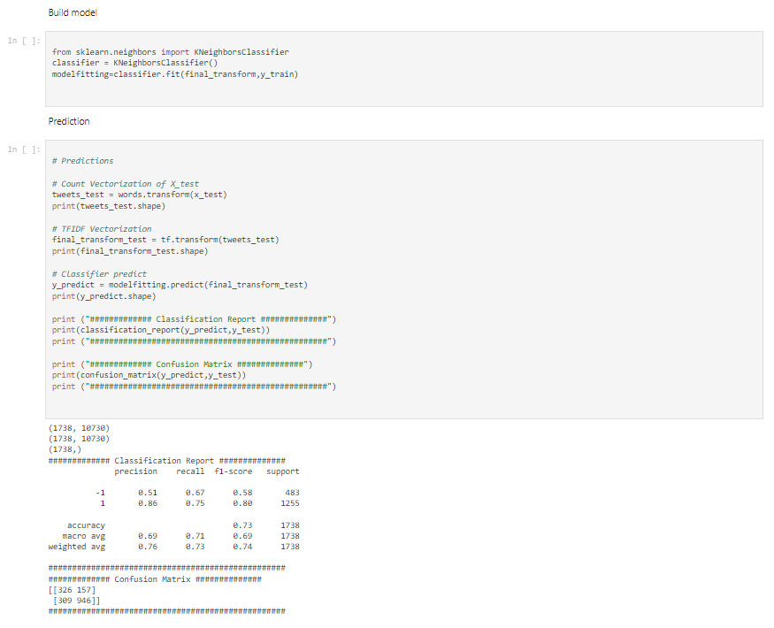
Stock Market Tweet Analysis
Results
K Nearest Neighbors Classifier:
The k-nearest neighbors' algorithm, also known as KNN or k-NN, is a non-parametric, supervised learning classifier, which uses proximity to make classifications or predictions about the grouping of an individual data point. While it can be used for either regression or classification problems, it is typically used as a classification algorithm, working off the assumption that similar points can be found near one another.

Slide 17

Stock Market Tweet Analysis
Results
Random Forest Classifier:
Random forest is a supervised learning algorithm which is used for both classification as well as regression. But however, it is mainly used for classification problems. As we know that a forest is made up of trees and more trees means more robust forest. Similarly, random forest algorithm creates decision trees on data samples and then gets the prediction from each of them and finally selects the best solution by means of voting. It is an ensemble method which is better than a single decision tree because it reduces the over-fitting by averaging the result.

Slide 18
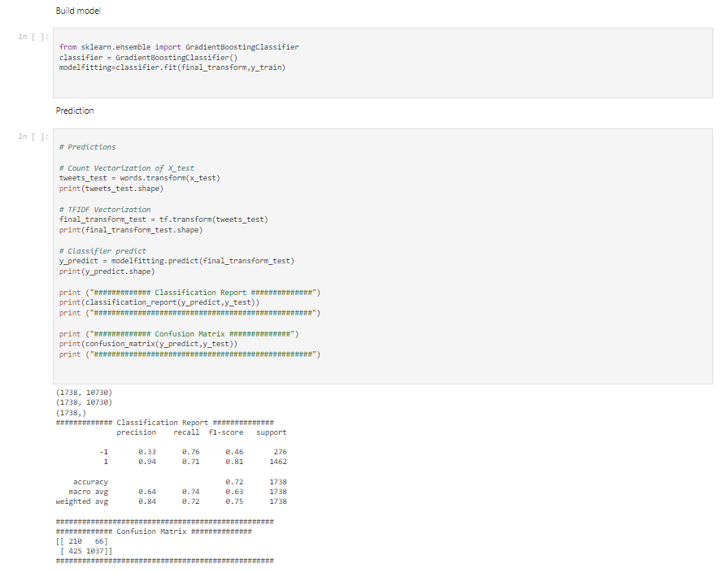
Stock Market Tweet Analysis
Results
Gradient Boosting Classifier:
This algorithm builds an additive model in a forward stage-wise fashion; it allows for the optimization of arbitrary differentiable loss functions. In each stage n_classes_ regression trees are fit on the negative gradient of the loss function, e.g. binary or multiclass log loss. Binary classification is a special case where only a single regression tree is induced.

Slide 19
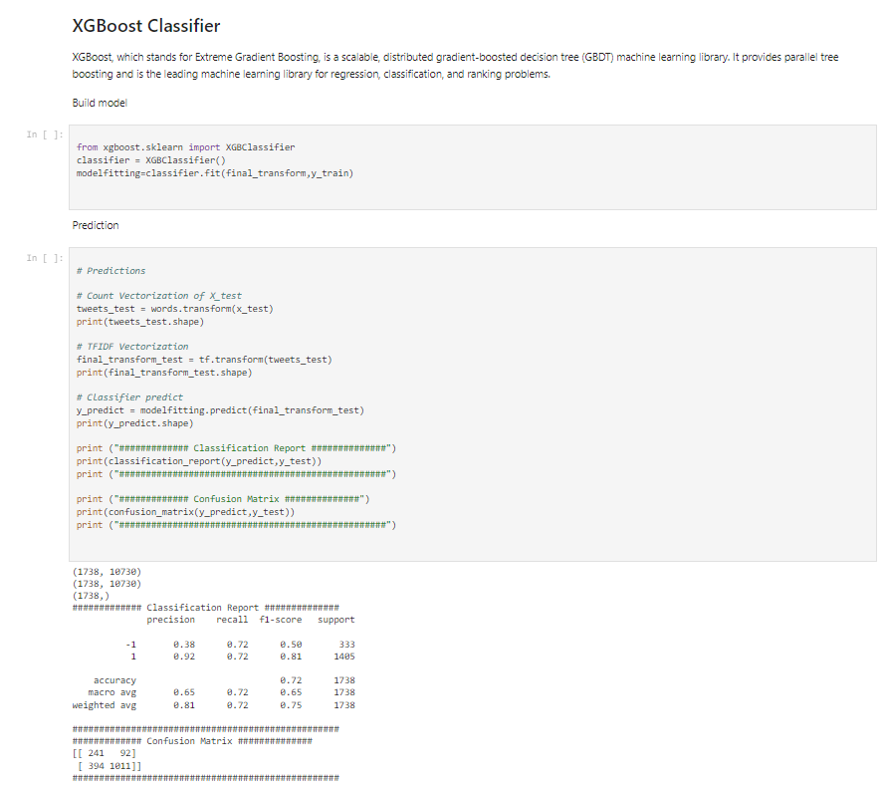
Stock Market Tweet Analysis
Results
XGBoost Classifier:
XGBoost, which stands for Extreme Gradient Boosting, is a scalable, distributed gradient-boosted decision tree (GBDT) machine learning library. It provides parallel tree boosting and is the leading machine learning library for regression, classification, and ranking problems.

Slide 20
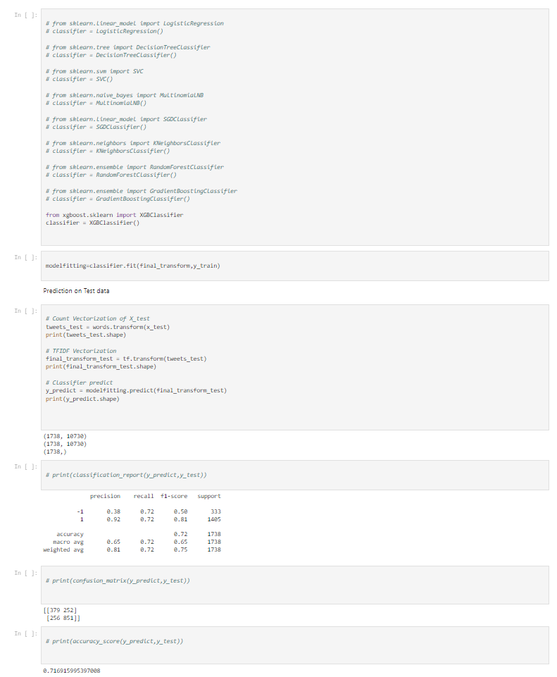
Stock Market Tweet Analysis
Results
Classifier testing:
Classifier on input
Multinomial Naive Bayes Classifier

Slide 21
THANK YOU

